Slide 1

Peak Shaving using Hydrogen Energy Storage System with Heat Coupling
Maxime Fischer
Mai 14, 2024 - Zurich
Notes:
Welcome everyone! Thank you for being here for the midterm presentation of my master's thesis, titled Peak Shaving using Hydrogen Energy Storage System with Heat Coupling.
After a short introduction, I will present the research objectives of my thesis and introduce you to the approach I've taken to get there.
I will then share some initial findings with you and wrap up by outlining what's coming next

Slide 2
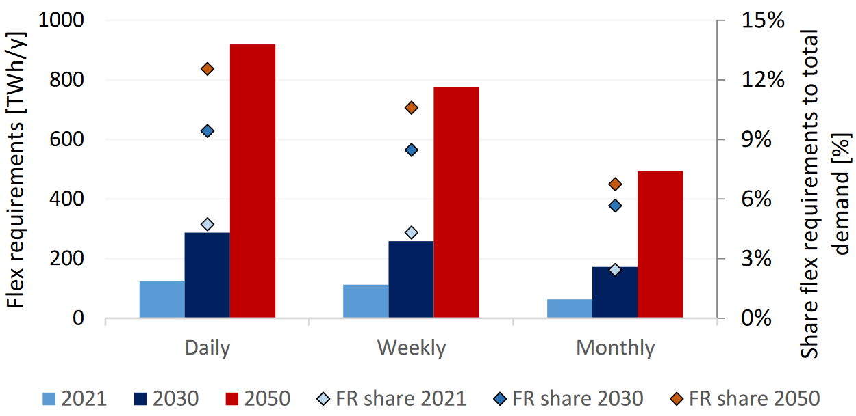
Motivation
In the broader context of the energy transition, electrification of energy systems is unavoidable to reduce carbon dioxide emissions and enhance efficiencies¹.
Challenges:
To effectively integrate renewables energy sources (RES) into today’s electricity systems, storage flexibilities and investments in grid infrastructure are required.
Heating and transport demand are highly peaked. Heating is strongly seasonal, but also with weekly variations and transport has strong daily periodicity².
Daily, weekly and monthly flexibility requirements and their share to total in the EU for 2021, 2030 and 2050³
1. Gabrielli, Paolo; Poluzzi, Alessandro; Kramer, Gert Jan; Spiers, Christopher; Mazzotti, Marco; Gazzani, Matteo (2020): Seasonal energy storage for zero-emissions multi-energy systems via underground hydrogen storage. In: Renewable and Sustainable Energy Reviews 121, S. 109629. DOI: 10.1016/j.rser.2019.109629.
2. T. Brown, Energy Systems Summer Semester 2023 – Lecture 13: Sector Coupling, https://nworbmot.org/courses/es-23/
3. KOOLEN, Derck; DE, FELICE Matteo; BUSCH, Sebastian (2022): Flexibility requirements and the role of storage in future European power systems. In: 1831-9424. DOI: 10.2760/384443.
Notes:
At the heart of the energy transition, we face the critical task of electrifying our energy systems.
This is a key strategy in reducing carbon dioxide emissions and increasing overall efficiency.
However, this transition comes with its own set of challenges which set the stage for the work we're doing in this thesis.
Firstly, if we want to integrate renewable energy sources effectively into our electricity system, we need to consider two things: storage flexibility and the necessary investments in grid infrastructure.
Secondly, we observe that both heating and transport demands peak significantly at certain times. Heating shows a strong seasonal pattern, peaking during the winter, and also fluctuates within the week. Transport, on the other hand, has a pronounced daily pattern.

Slide 3
Motivation
Idea:
Sector coupling: couple the electricity sector to heating and mobility. This enables decarbonisation of these sectors and offers more flexibility to the power system with regards to storage (short to long term) and demand-side management.
Within this framework, Hydrogen Energy Storage Systems (HESS) have recently caught much attention due to their ability to compensate the seasonal intermittency of renewable energy sources and enhancing energy security¹.
Implementing Hydrogen Energy Storage Systems for peak shaving could effectively optimize network costs and adapt to fluctuating loads.
HESS
Peak Shaving
Heat & Power Generation
Seasonal Storage
Notes:
So how can we tackle these challenges?
The strategy behind sector coupling is to link the electricity sector to other energy sectors like heating and mobility.
The goal here is twofold: we aim for decarbonization and we strive for increased flexibility to the power system with regards to storage solutions (short to long term) as well as demand-side management.
Within this broader concept, Hydrogen Energy Storage Systems or HESS have emerged as a noteworthy solution.
Their rising popularity can be attributed to their ability to balance out the seasonal fluctuations of renewable energy sources and providing energy security
To sum up, sector coupling and HESS are at the forefront of our efforts to create a more resilient, sustainable, and secure energy landscape.

Slide 4
Objectives
What is the optimal design of a Hydrogen Energy Storage System with heat coupling that allows for minimal investment and operational costs?
How sensitive is the model with regard to the input parameters?
To what extent does the adoption of Waste Heat Recovery systems affect the Levelised Cost of Energy ?
How is the optimal design changing when considering grid transmission and distribution charges
Notes:
This brings us to the objectives that guide my research:
I aim to determine what is the optimal design of a hydrogen energy storage system with heat coupling, that allows for minimal investment and operational costs?
Secondly, I want to examine the model's sensitivity to input parameters which is essential for predicting how changes in the environment or market could impact the system's performance.
The third objective looks at the integration of waste heat recovery. We're interested in quantifying how these systems can reduce the Levelized Cost of Energy
Lastly, we consider how the optimal design adapts when we include the grid fees associated with power peaks.

Slide 5
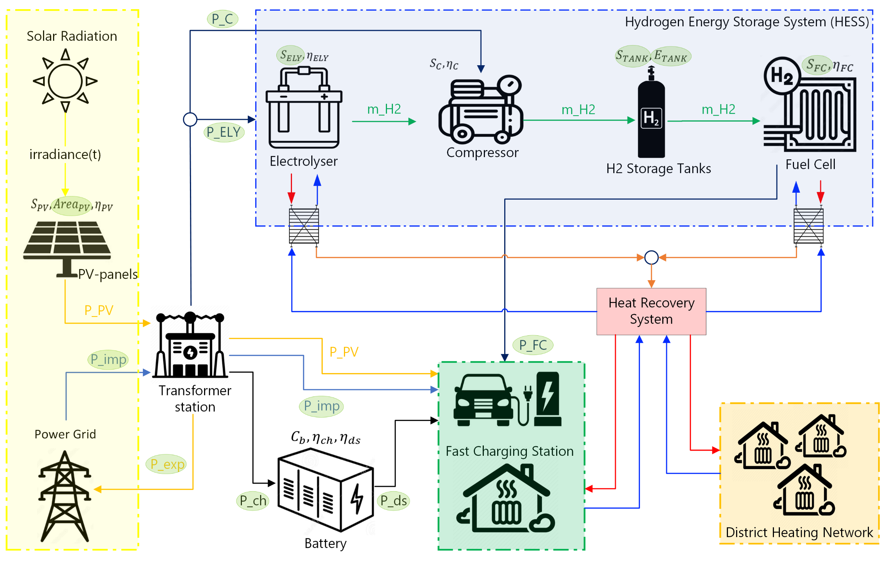
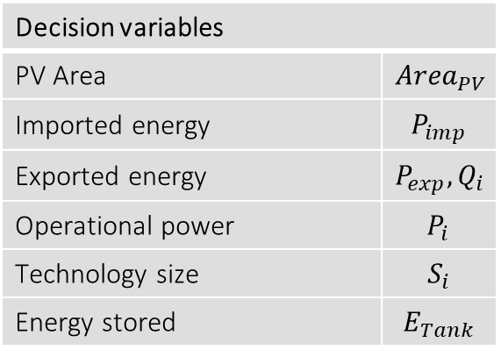
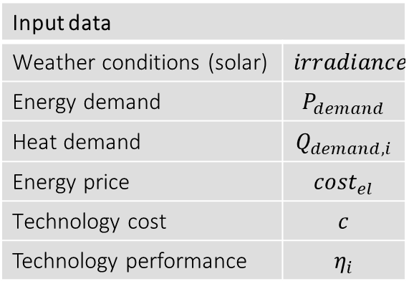
System Overview
Input data
Weather conditions (solar) | $$irradiance$$
Energy demand | $$P_{demand}$$
Heat demand | $$Q_{demand,i}$$
Energy price | $${cost}_{el}$$
Technology cost | $$c$$
Technology performance | $$η_{i}$$
Decision variables
PV Area | $${Area}_{PV}$$
Imported energy | $$P_{imp}$$
Exported energy | $$P_{exp}, Q_{i}$$
Operational power | $$P_{i}$$
Technology size | $$S_{i}$$
Energy stored | $$E_{Tank}$$
Elec. Power flow
H2 flow
Heat flow (medium and high Temp.)
Notes:
This slide provides a overview of the considered system.
At the core of our setup is a fast charging station which is connected to the electric grid via a transformer station.
Next to this fundamental setup, we consider a hydrogen based energy storage system (HESS) as a flexibility option.
The role of the storage system is to address and mitigate peak power demands from Battery Electric Vehicles while efficiently storing excess energy during times of low demand.
In addition our system integrates an on-site PV power facility and
Finally, waste heat recovery is considered which can be utilized for both on-site needs and residential heating, optimizing energy usage and reducing waste.
Together, these components form a multi-energy-system aimed at enhancing energy efficiency, reducing peak loads, and integrating renewable energy sources.

Slide 6
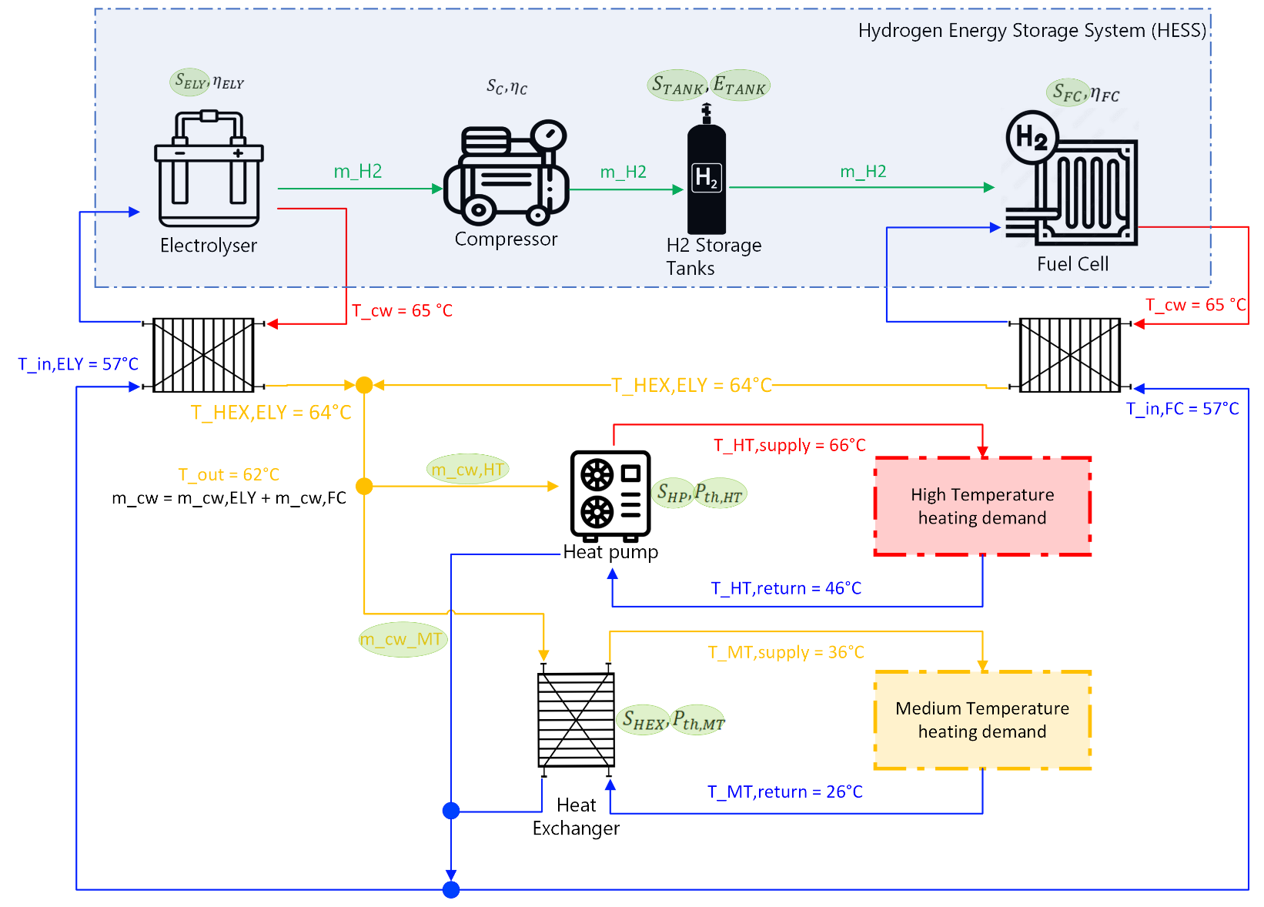
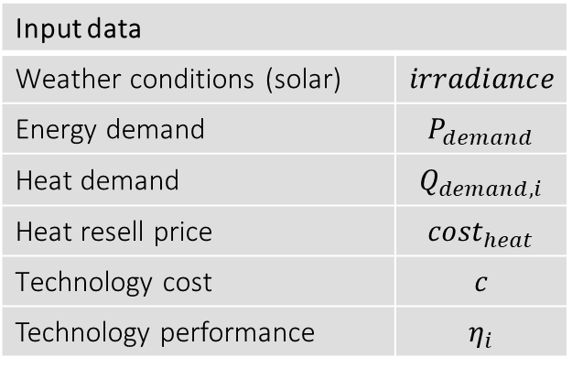
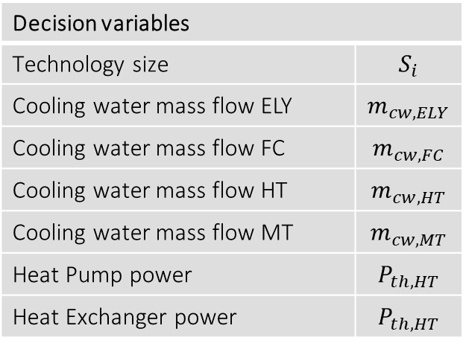
Waste Heat Recovery System
Input data
Weather conditions (solar) | $$irradiance$$
Energy demand | $$P_{demand}$$
Heat demand | $$Q_{demand,i}$$
Heat resell price | $${cost}_{heat}$$
Technology cost | $$c$$
Technology performance | $$η_{i}$$
Decision variables
Technology size | $$S_{i}$$
Cooling water mass flow ELY | $$m_{cw,ELY}$$
Cooling water mass flow FC | $$m_{cw,FC}$$
Cooling water mass flow HT | $$m_{cw,HT}$$
Cooling water mass flow MT | $$m_{cw,MT}$$
Heat Pump power | $$P_{th,HT}$$
Heat Exchanger power | $$P_{th,HT}$$
Low, Medium and High Heat flow
H₂ flow

Slide 7
Methodology
A single layer (SL) optimization framework has been implemented to perform and evaluate the optimal design of the multi-energy system, considering a time horizon of one year.
Compared to two layer optimizations, where design and operation are decoupled, SLs optimizations provides lower cost solutions and improved system performances⁴.
INPUT DATA
DATA PROCESSING
MILP RUN
Weather data
Component modelling
Variables to optimize
Decision variables
Component sizes
Operating variables
Operating power of components at each time step
Objective Function
Minimization of the Total Annual Cost
Energy demand:
Heat and electricity
PWA approximation of efficiencies and cost curves
Electricity prices
Technical specifications
POST-PROCESSING
4. M. A. Giovanniello and X.-Y. Wu. “Hybrid lithium-ion battery and hydrogen energy storage systems for a wind-supplied microgrid”. In: Applied Energy 345 (2023)
Evaluation of the Levelized Cost of Energy
Sensitivity analysis for different scenarios
Notes:
We've implemented a single-layer optimization framework to evaluate the optimal design of our multi-energy system over a one-year time horizon.
By employing a single-layer strategy, we optimize for both design and operation at the same time which according to the literature results in more cost-effective solutions and improved system performance.
The input data of the model are weather conditions, energy demand for both heat and electricity, electricity prices, and the technical specifications of the system components, which refer to their cost and efficiencies.
In the data processing stage, component modelling was performed. I am also thinking of using piecewise affine approximations to capture the non-linear efficiency of the components and cost relationships.
The core of our optimization process is the Mixed-Integer Linear Programming run.
Here we utilize Gurobi as solver in Python, which processes our input data and variables to find the most cost-effective combination of technology sizes and operational strategies to minimize overall system costs.
Post-processing involves evaluating the Levelized Cost of Energy and conducting a sensitivity analysis to assess how changes in input parameters could affect the outcomes.
In summary, this methodology allows us to strike a balance between economic and technical considerations, leading to an optimal system design that's both practical and cost-effective

Slide 8


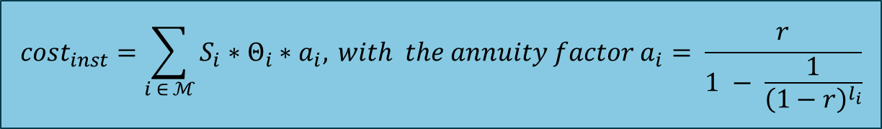
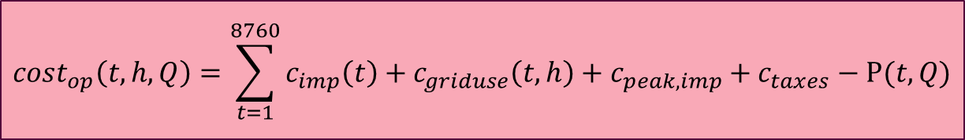
Objective function: minimize the Total Annual Cost (TAC)
$\min\left(TAC\right)= {cost}_{inst} + {cost}_{op} + {cost}_{maint}$
With the set of technologies $i ∈ ℳ= \left\{PV,BAT,ELY,C,TANK,FC,HP,HEX\right\}$ with capacities $S_{i}$
$${cost}_{inst}=\sum_{i ∈ ℳ}{S_{i}∗Θ_{i}∗a_{i}, }with the annuity factor a_{i}= \frac{r}{1 − \frac{1}{{\left(1−r\right)}^{l_{i}}}}$$
$${cost}_{op}\left(t,h,Q\right)=\sum_{t=1}^{8760}{c_{imp}\left(t\right)+c_{griduse}\left(t,h\right)+c_{peak,imp}+c_{taxes}−Ρ(t,Q)}$$
$$∀i ∈ ℳ, {cost}_{maint}={cost}_{inst,i} ∗ ψ_{i}$$

Slide 9
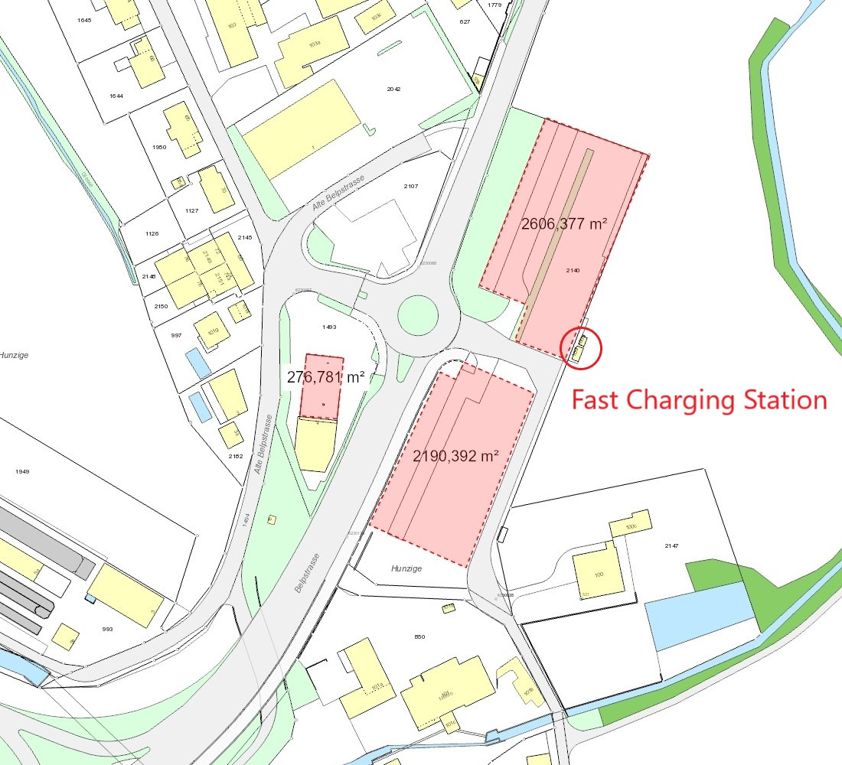
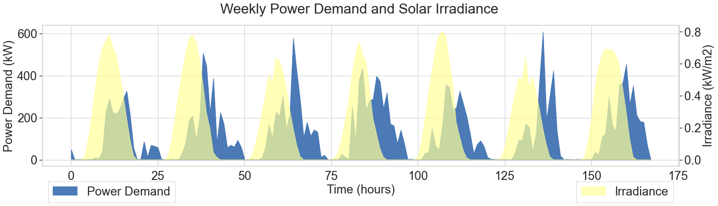
Case study
The model operates with realistic data considering a time horizon of one year with hour resolution.
Electricity demand from Tesla Supercharger station in Rubigen¹
High-resolution cost function with tariffs of the local distribution grid operator BKW²
Irradiance and ambient Temperature profiles for Rubigen in Switzerland³
1. tesla
2. BKW
3. NASA
4. https://www.empa.ch/web/nest
Notes:
I utilize realistic data as input parameter for the MILP run to ensure the model's relevance.
The electricity demand data is sourced from the Tesla Supercharger station located in Rubigen, which is near to Bern in Switzerland.
I have plotted the power demand and the irradiance over a typical week. What stands out is the occurrence of power peaks during periods of low solar availability, which again highlights the need for storage.
We have further incorporated electricity prices from the ENTSOE platform and irradiance data for Rubigen from the Nasa website.
The heat demand profiles are taken from the NEST building at EMPA
ENTSOE = (European Network of Transmission System Operators for Electricity)

Slide 10
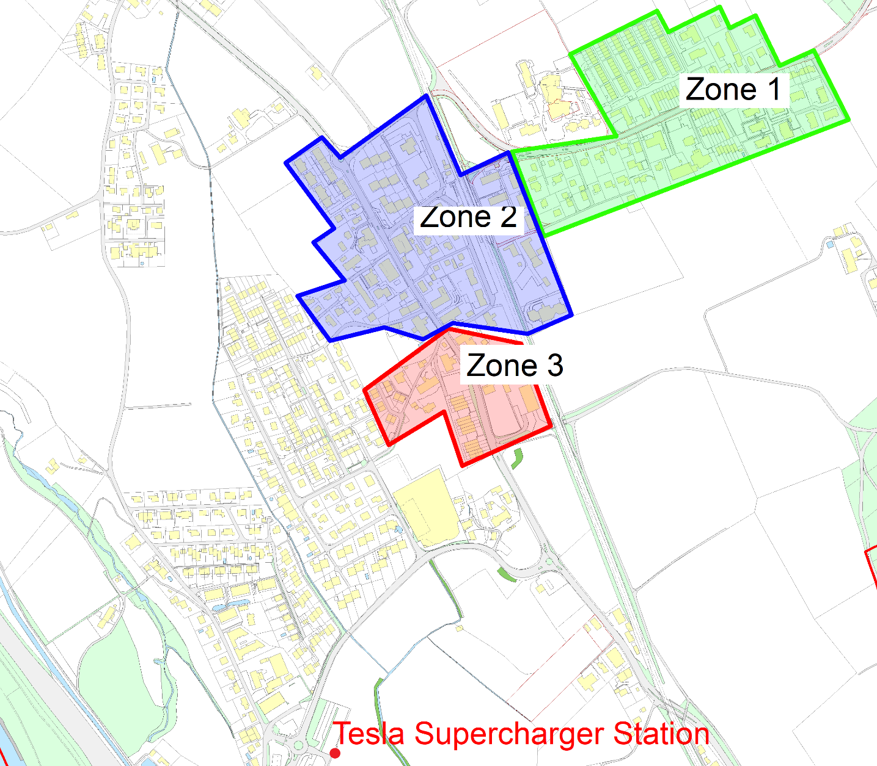
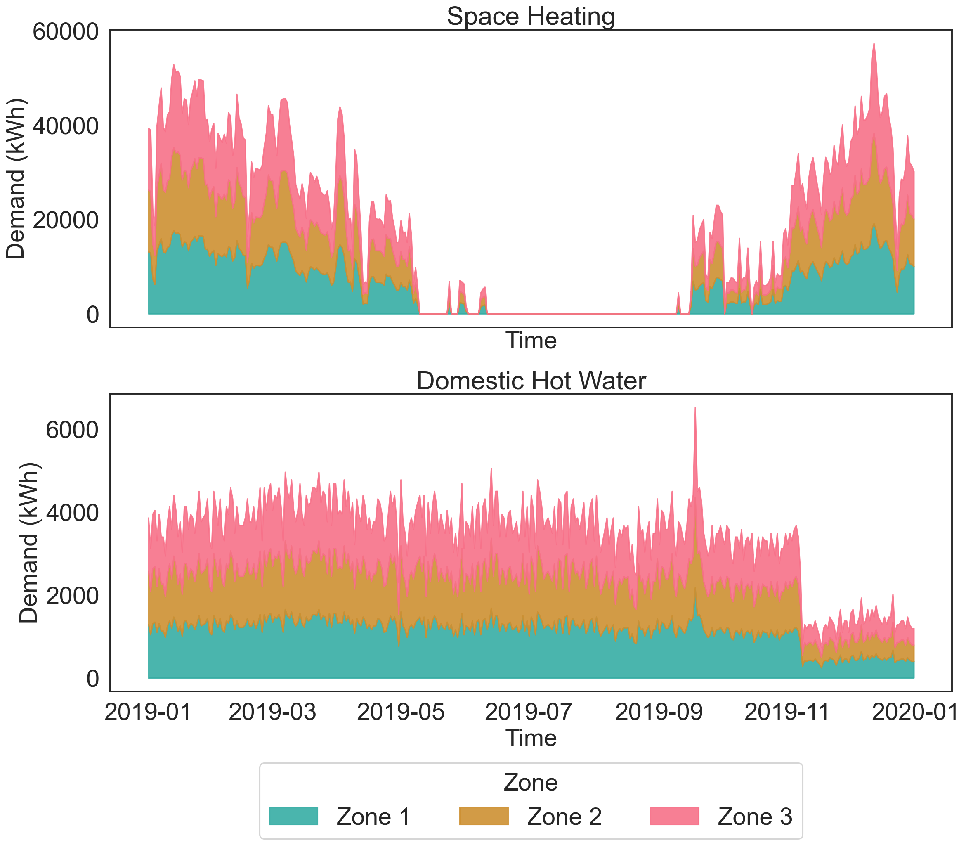
Case Study – DHN and Heat demand

Slide 11
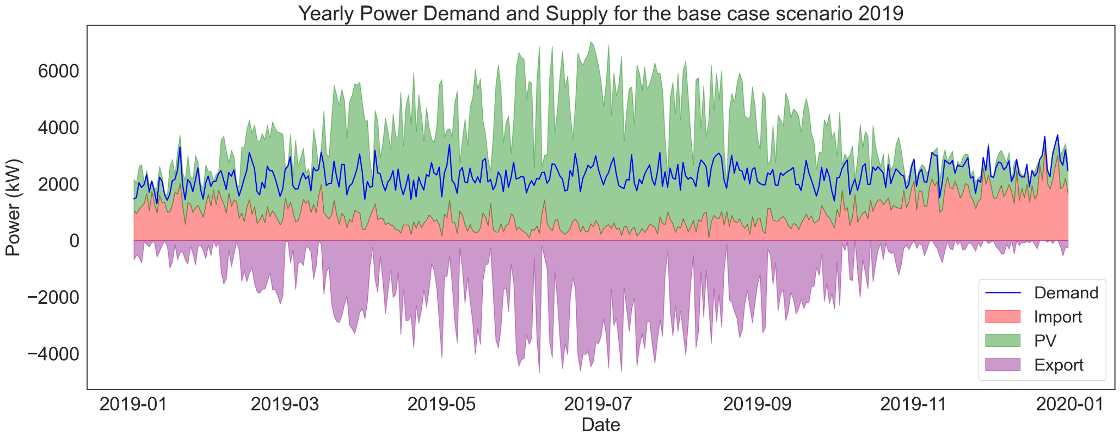
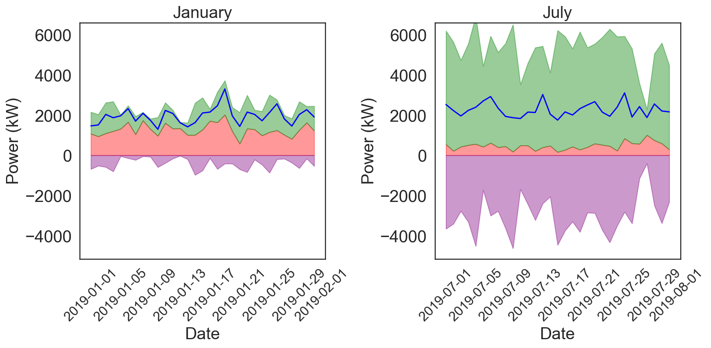
Base Case Scenario 2019
Seasonal Variability and Grid Dependency: During winter, decreased solar irradiance necessitates increased grid imports to meet energy demands.
Optimization Strategy:
The model prioritizes electricity generation from photovoltaics (PV) which is then exported to the grid to minimize costs.
Non-utilization of HESS:
The Hydrogen Energy Storage System (HESS) remained unused, likely due to the substantial initial investment costs associated with its components, such as the Electrolyser and Fuel Cell.
Notes:
Introduction: The optimization was run for the base case scenario in 2019, where the maximum PV area was set to 6000 square meters.
Discuss Seasonal Impact: Explain how seasonal changes influence solar energy production and the resulting increased reliance on grid imports during winter. Use the yearly graph to highlight the fluctuating supply and demand over the year.
Optimization Details: Shift focus to the optimization strategy used in the scenario. Detail how maximizing PV output and exporting surplus electricity helps in reducing operational costs. Reference the specific months shown in the smaller graphs to illustrate differences in energy production in winter and summer.
HESS Discussion: Address the non-utilization of the Hydrogen Energy Storage System. Explain the economic considerations, particularly the high upfront costs, that influenced this decision. Emphasize the importance of balancing technology benefits with financial viability.
Conclusion and Implications: Conclude by summarizing the key points and discussing the implications of these findings for future strategic decisions in energy storage and production.
The power demand is represented in blue in the top plot and is met by PV generation (in green here), as well as grid imports (in pink).
The green line represent the electricity exports to the grid.
The seasonal fluctuations in solar irradiance are leading to increased grid imports during the winter months when sunlight is less available.
Also, the optimizer's strategy here is to maximize electricity production from the PV system. This electricity is then exported back to the grid whenever it's not immediately needed reducing the overall system expenses.
Unfortunately in our base case scenario for 2019, the optimizer did not select to operate the Hydrogen Energy Storage System.
This decision can be attributed to two main factors:
First, the high investment costs associated with HESS components, particularly the Electrolyzer and the Fuel Cell.
Second, the cost function fidelity is not high enough and doesn’t take into account grid fees associated to high import and export peak.
The graph here illustrates the breakdown of costs function into installation, operation and maintenance costs.
CHRISTIAN:
3rd point, potential errouros implementation ;) you do not need to list it, though..

Slide 12
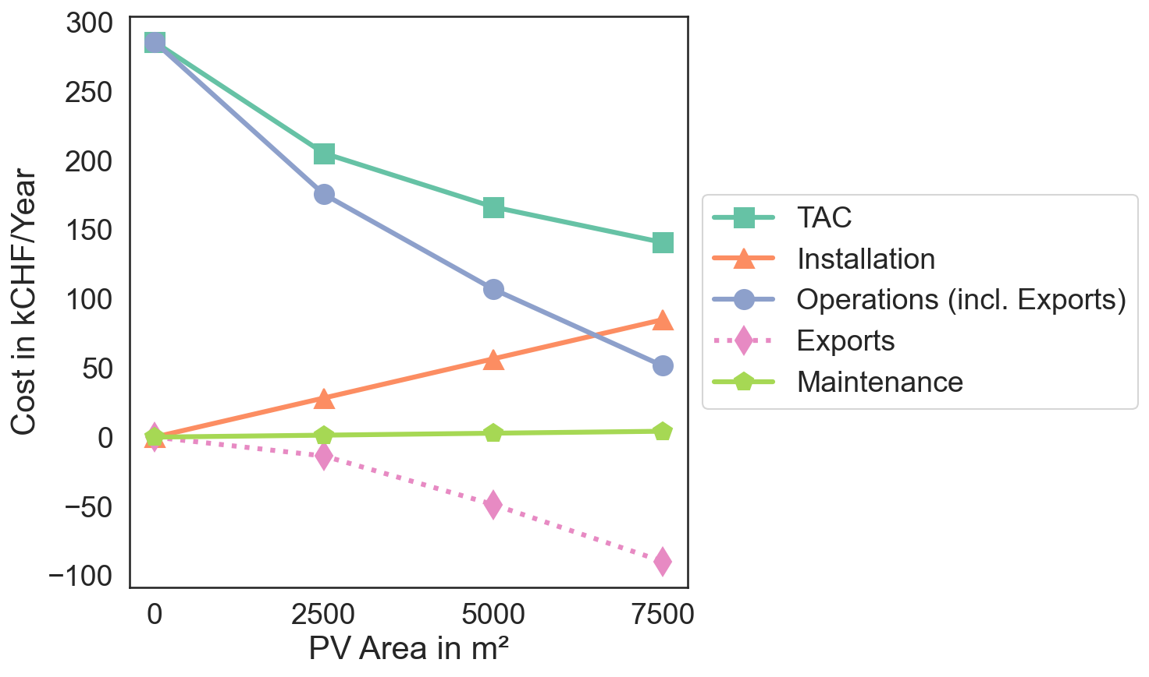
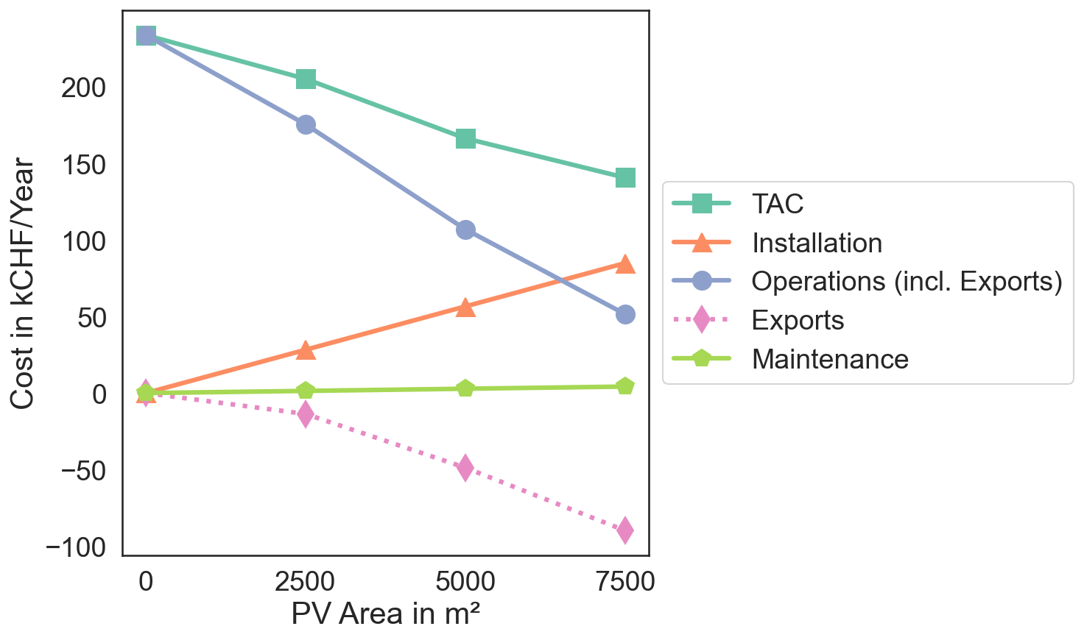
Evaluating the Cost Benefits of Integrating PV
Renewable integration, such as PV panels, significantly cuts Total Annual Costs (TAC). With PV integration:
TAC reduces by 42% in the Base Case Scenario.
TAC reduces by 51% when PV area is maximized to 7500m².
BC
Notes:
Since no HESS was used in the base case scenario, a first approach was to reduce the unit prices for HESS components and increase their efficiencies to see how they’ll impact the results.
Key Insight: Demonstrate how increasing the area dedicated to PV panels drastically reduces energy costs.
Data Overview:
Graph Explanation: Illustrates cost trends across different components (TAC, Installation, Operations, Exports, Maintenance) as PV area increases.
Red Box Analysis (Base Case): Highlights significant cost reduction when PV area is between 2500 m² and 5000 m².
Cost Reduction Highlights:
42% Reduction: Achieved in the Base Case scenario.
51% Reduction: When PV area reaches 7500 m².
Conclusion:
Strategic Recommendation: Maximize PV panel installation to capitalize on substantial cost savings.
Long-Term Benefit: Enhanced sustainability and reduced operational costs.

Slide 13
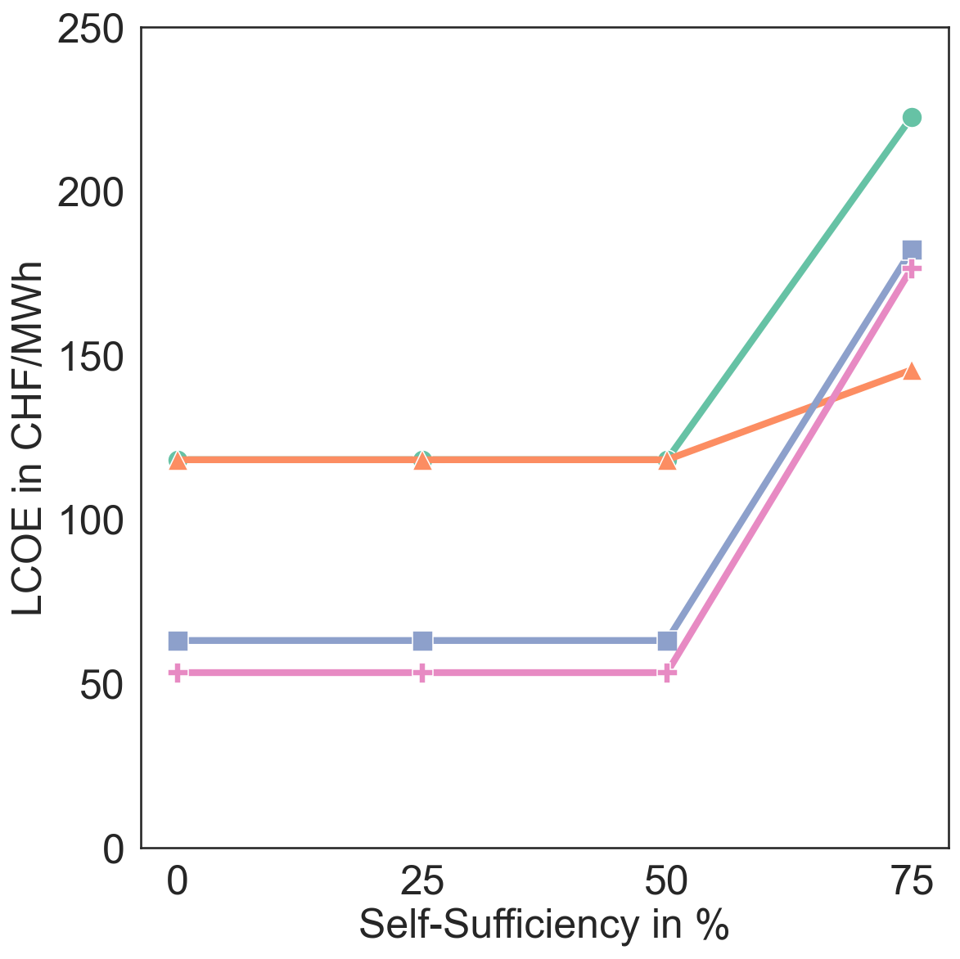
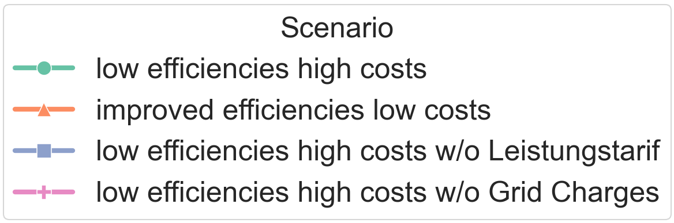
From Self-Sufficiency to HESS Integration: Advancing Site Capabilities
A self-sufficiency level of 75% means that the grid imports, in sum, can only account for 25% of the total electricity demand.
At this high level of self-sufficiency, HESS integration becomes necessary - not for economic efficiency but due to grid import limitations.
Notes:
In a next step, self sufficiency's tests were conducted by enhancing the self-sufficiency of the system

Slide 14
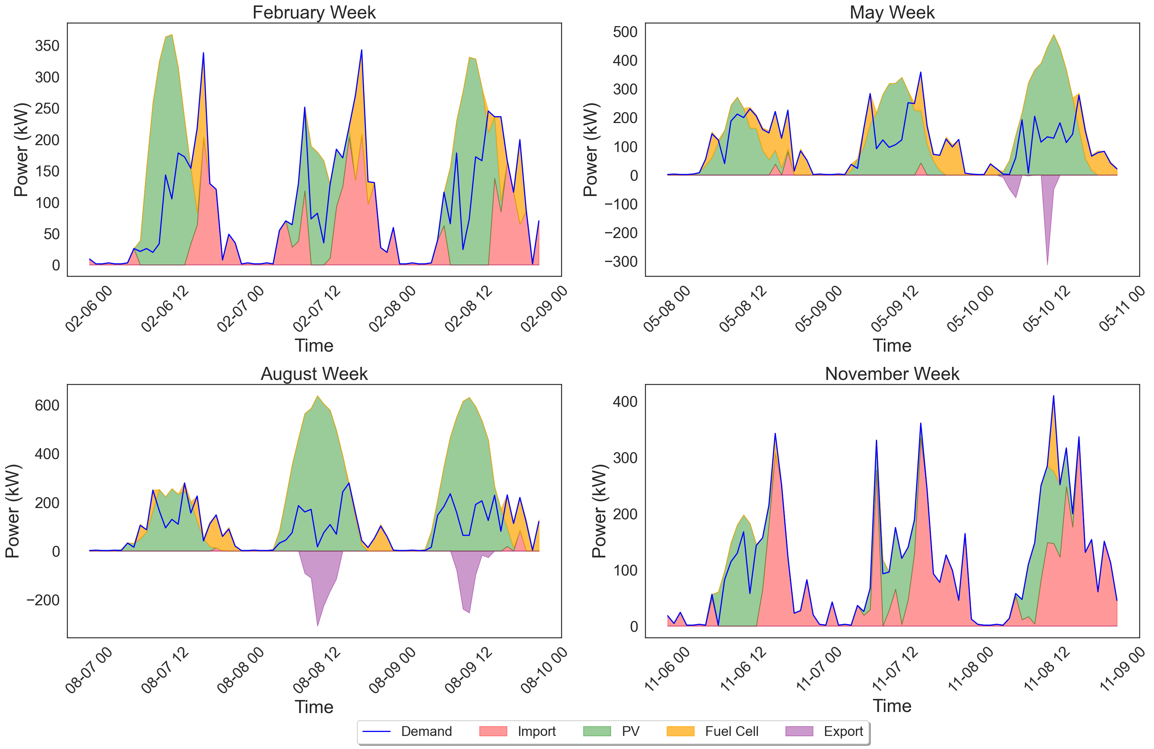
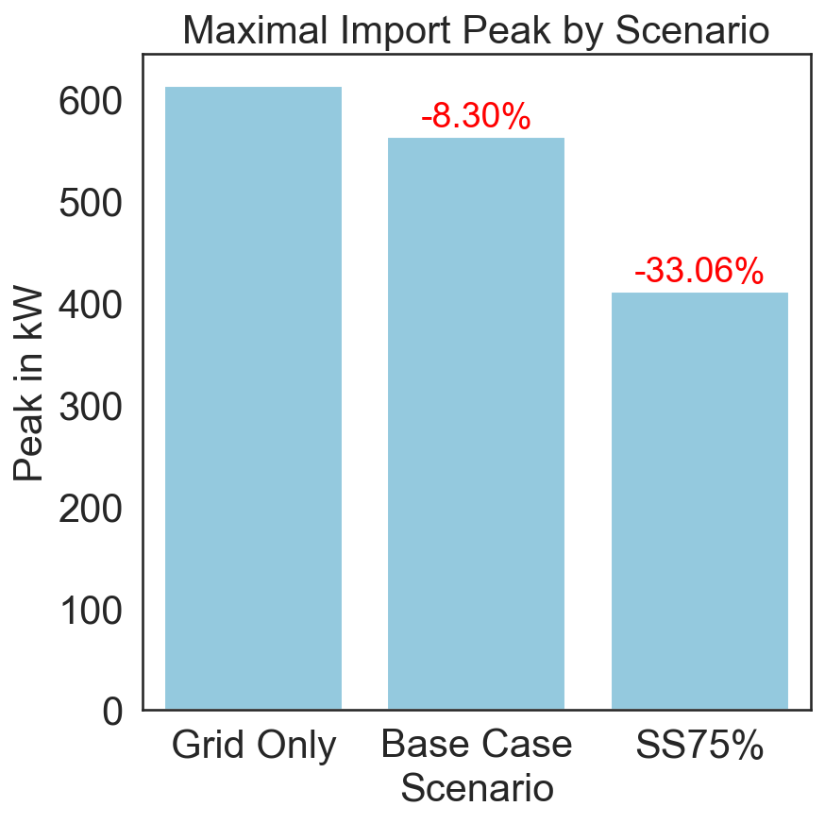
Peak Shaving
The HESS accounted for approximately 18% of the total power demand.
Notes:
Introduction to Peak Shaving:
Begin by explaining the concept of peak shaving in energy management. Describe it as a strategy used to reduce the maximum power demand during peak usage times, which can result in lower energy costs and improved stability of the power grid.
Highlight the Role of HESS:
Introduce the Hydrogen Energy Storage System (HESS) as a key technology in this strategy. Mention that in this analysis, HESS accounted for approximately 18% of the total power demand reduction.
Examine the Graph "Maximal Import Peak by Scenario":
Direct attention to the bar graph showing the maximal import peak across different scenarios. Point out that in the 'Grid Only' scenario, the peak is the highest. Compare this to the 'Base Case Scenario' and 'S75%' scenarios, where the introduction of HESS leads to a significant reduction in peak demand (noted as -8.30% and -33.06%, respectively).
Detailed Analysis of Seasonal Variability:
Move on to discuss the four smaller graphs depicting energy usage during different weeks of the year—February, May, August, and November.
For each graph, explain the color coding and what each segment represents (e.g., demand, import, HESS input/output). Emphasize how HESS contributes to managing demand peaks during these times.
Discuss the Implications:
Highlight the importance of using HESS for peak shaving, especially during critical times of the year when energy demand spikes or when renewable energy sources might be less effective (like during winter or cloudy days).
Discuss how deploying HESS can help reduce dependence on the grid, lead to cost savings, and support a more sustainable energy system.
Conclusion and Takeaways:
Summarize the benefits of integrating HESS into the energy system as demonstrated by the data. Reinforce the value of peak shaving in managing energy costs and enhancing grid reliability.
Conclude by inviting questions or comments to deepen the discussion on the technology's potential or explore other aspects of its application in energy management.

Slide 15
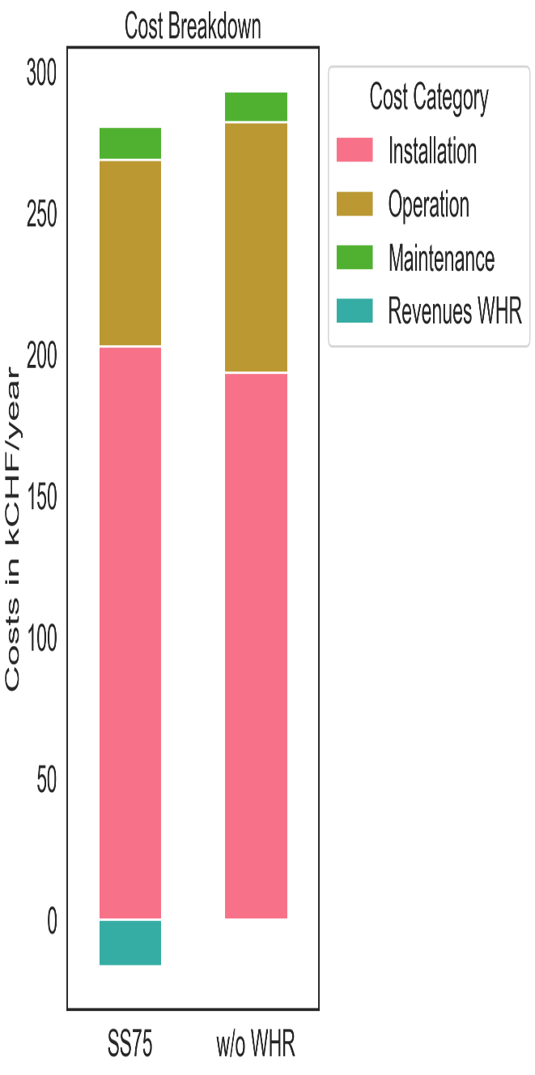
Benefits from integrating Waste Heat Recovery
Integrating WHR reduces the LCOE by 4%.
In addition, the integration of heat recovery leads to different system configurations. Accordingly, the capacity of the fuel cell, which recovers the most heat, is reduced by 23%.
Sizes | SS75 | w/o WHR | %change
PV (kW) | 824 | 824 | 0%
ELY (kW) | 295 | 314 | +6%
TANK (MWh) | 26 | 32 | +18%
FC (kW) | 152 | 124 | -23%
HEX (m2) | 2 | 0 | -100%
HP | 64 | 0 | -100%

Slide 16
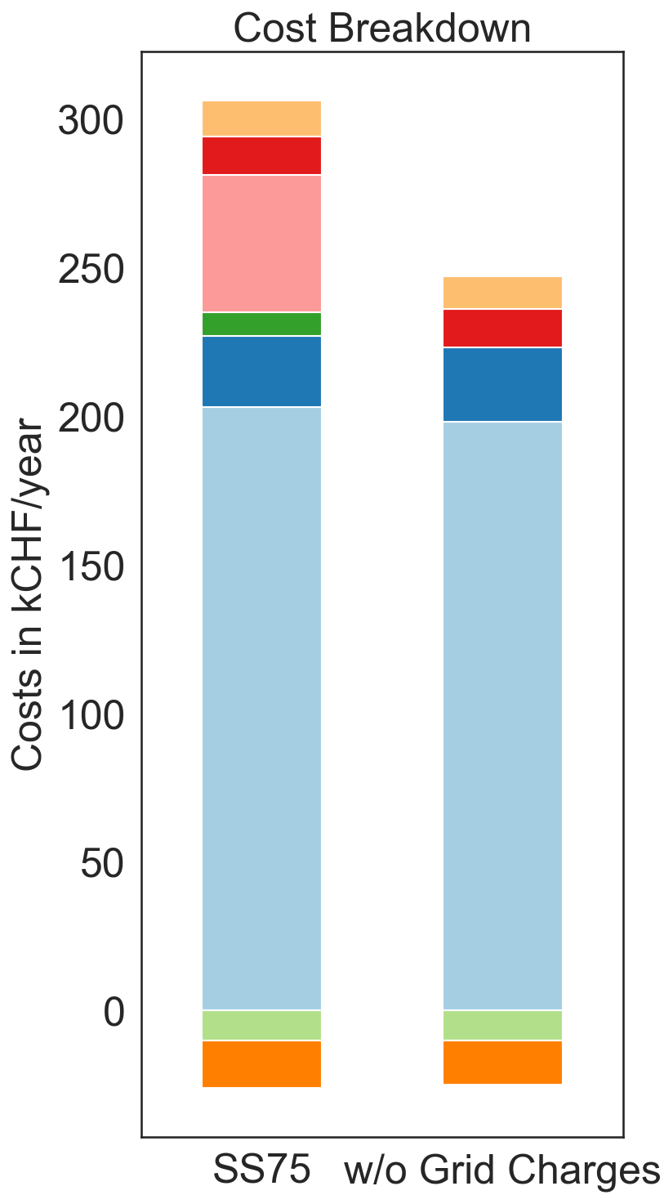
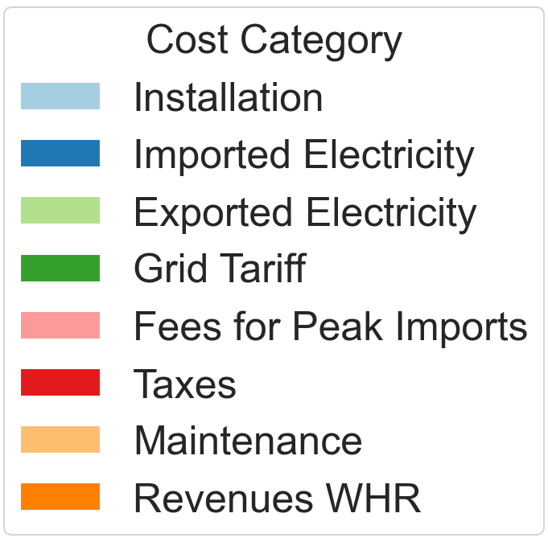
Impact of adding grid charges on the LCOE
Impact of Grid Charges on LCOE:
Removal of grid charges results in a 22% reduction in LCOE, with fees for peak imports constituting the majority of these charges.
Adjustments in Technology Capacities:
Exclusion of grid charges leads to an increase in ELY and TANK capacities, while reducing the need for FC capacity, illustrating the shift in operational strategies for energy management.
 | SS75 | w/o Grid Fees | % change
PV (kW) | 824 | 824 | 0%
ELY (kW) | 294 | 326 | +11%
TANK (MWh) | 26 | 30 | +16%
FC (kW) | 151 | 126 | -17%
HEX (m²) | 1.7 | 1.4 | -17%
HP (kW) | 64 | 57 | -11%

Slide 17
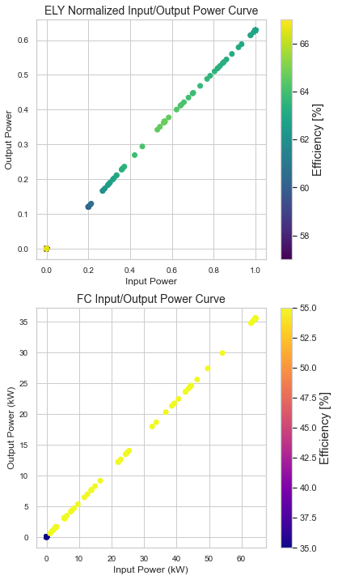
Adding PWA approximations to the model

Slide 18
Conclusions
The results from the model show that the economical operation of Hydrogen Energy Storage System is only achievable in scenarios with enhanced self-sufficiency.
The integration of waste heat recovery represents a promising path towards future integration of hydrogen storage system in our energy system.
Including grid fees to the model significantly affects the LCOE. However, despite the higher operational costs, HESS is not considered in the system configuration.

Slide 19

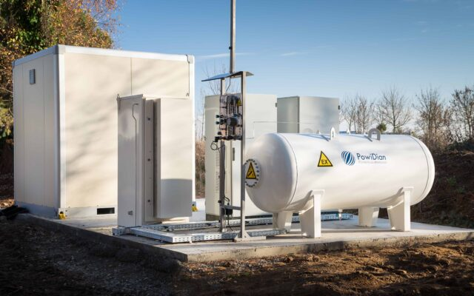
Outlook
Further work could include:
Extend the model with new objectives, e.g. minimize CO₂ emissions
Consider by products like oxygen to generate revenues.
Introduce other Hydrogen Storage Technologies (metalhydrides, cryo-compressed hydrogen storage)
Create scenarios with predicted future electricity prices
Notes:
https://www.enapter.com/de/application/peak-shaving-with-hydrogen/#21337
Peak Shaving mit Wasserstoff
Loire Acquitaine, Frankreich
Delta Green ist das erste autarke Bürogebäude in Frankreich, in dem Energieerzeugung den Verbrauch übersteigt. Das Ziel von Delta Green ist es, vollständige Energieautonomie zu demonstrieren. Der Energiemix des Gebäudes besteht aus Photovoltaik und Geothermie. Die Wasserstofflösung wurde von PowiDian integriert. Anstelle von Batterien, verwendet das Tertiärgebäude zwei Enapter-Elektrolyseure, um Wasserstoff für die Abdeckung von Lastspitzen zu speichern. Nicht nur wird zu Spitzenzeiten der Bezug von Strom aus dem Netz vermieden, Wasserstoff dient auch zum Zweck der saisonalen Speicherung. Das Passivhaus hat einen minimalen CO2-Fußabdruck bei Beleuchtungs-, Heizungs- und Kühlsystemen.
Im Jahr 2018 wurde das innovative Gebäude mit dem Green Solutions Award ausgezeichnet, der umweltbewusste Architektur auszeichnet und zur Bekämpfung des Klimawandels beiträgt.
Weitere Informationen hier und hier (auf Französisch).

Slide 20
Thank you for your attention !

Slide 21
References

Slide 22
Technical Parameter
Technical parameter of the components
Parameter | PV | BAT | ELY | Comp | Tank | FC | HP | HEX | References
Component life in [years] | 25 | 10 | 10 | 20 | 35 | 5 | 20 | 20 | [1],[2],[3]
Efficiency (current) in [%] | 21 | 95 | 65 | 75.26 | 95 | 52 | - | - | [2],[4]
Efficiency (idealistic) in [%] | 21 | 95 | 80 | 90 | 99 | 70 | - | -
Installation costs (current) in [CHF/kW] | 800 |  | 1700 | 7.6 | 9.34 [€/kWh] | 2000 |  |  | [3],[4],[5],[6]
Installation costs (midterm) in [CHF/kW] | 800 |  | 556 | 3.8 | 7.74 [€/kWh] | 600 |  |  | [5],[6]
Maintenance cost in [% of total cost] | 5 | 2 | 5 | 6 | 3 | 8 | 1,5 | 2 | [5]
Maximal size in [kW] | 1260 |  | 1000 | 100 | 811 kgH2 | 1000
[1] Le, Tay Son; Nguyen, Tuan Ngoc; Bui, Dac-Khuong; Ngo, Tuan Duc (2023): Optimal sizing of renewable energy storage: A techno-economic analysis of hydrogen, battery and hybrid systems considering degradation and seasonal storage. In: Applied Energy 336, S. 120817. DOI: 10.1016/j.apenergy.2023.120817.
[2] Pan, Guangsheng; Gu, Wei; Qiu, Haifeng; Lu, Yuping; Zhou, Suyang; Wu, Zhi (2020): Bi-level mixed-integer planning for electricity-hydrogen integrated energy system considering levelized cost of hydrogen. In: Applied Energy 270, S. 115176. DOI: 10.1016/j.apenergy.2020.115176.
[3] Wang, Ruilian; Zhang, Rongxin (2023): Techno-economic analysis and optimization of hybrid energy systems based on hydrogen storage for sustainable energy utilization by a biological-inspired optimization algorithm. In: Journal of Energy Storage 66, S. 107469. DOI: 10.1016/j.est.2023.107469.
[4] Minutillo, M.; Perna, A.; Forcina, A.; Di Micco, S.; Jannelli, E. (2021): Analyzing the levelized cost of hydrogen in refueling stations with on-site hydrogen production via water electrolysis in the Italian scenario. In: International Journal of Hydrogen Energy 46 (26), S. 13667–13677. DOI: 10.1016/j.ijhydene.2020.11.110.
[5] Gabrielli, Paolo; Gazzani, Matteo; Martelli, Emanuele; Mazzotti, Marco (2018): Optimal design of multi-energy systems with seasonal storage. In: Applied Energy 219, S. 408–424. DOI: 10.1016/j.apenergy.2017.07.142.
[6] International Energy Agency (2023): Global Hydrogen Review 2023 - IEA. IEA. France. Online verfügbar unter https://www.iea.org/reports/global-hydrogen-review-2023, zuletzt geprüft am 09.01.2024.

Slide 23
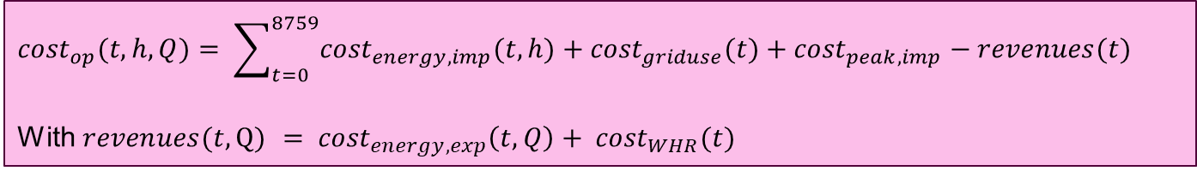
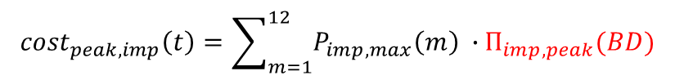
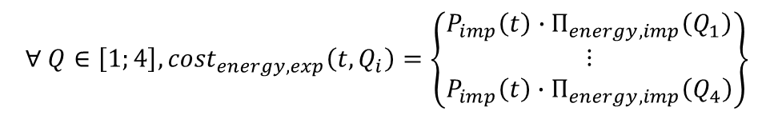
MILP Formulation: Objective Function – operational costs
$${cost}_{op}(t,h,Q)= \sum_{t=0}^{8759}{{cost}_{energy,imp}(t,h)+{cost}_{griduse}(t)+{cost}_{peak,imp}−revenues(t)}$$
With ${revenues(t,\text{Q}\text{)} = cost}_{energy,exp}\left(t,Q\right)+ {cost}_{WHR}(t)$
$$∀ h∈\left[0;23\right], {cost}_{energy,imp}\left(t,h\right)= \left\{\begin{matrix}P_{imp}\left(t\right)∙Π_{energy,imp}\left(h\right),if 7 ≤h <21 \\ P_{imp}\left(t\right)∙Π_{energy,imp}\left(h\right),if 21 ≤h <7\end{matrix}\right\}$$
$$∀ h∈\left[0;23\right], {cost}_{griduse}(t,h)= \left\{\begin{matrix}P_{imp}\left(t\right)∙Π_{griduse,hightariff}, if 7 ≤h <21 \\ P_{imp}\left(t\right)∙Π_{griduse,lowtariff}, if 21 ≤h <7\end{matrix}\right\}$$
$${cost}_{peak,imp}\left(t\right)=\sum_{m=1}^{12}{P_{imp,max}\left(m\right) ∙Π_{imp,peak}(BD)}$$
$${∀ Q∈\left[1;4\right],cost}_{energy,exp}\left(t, Q_{i}\right)=\left\{\begin{matrix}P_{imp}\left(t\right)∙Π_{energy,imp}\left(Q_{1}\right) \\ ⋮ \\ P_{imp}\left(t\right)∙Π_{energy,imp}\left(Q_{4}\right)\end{matrix}\right\}$$

Slide 24
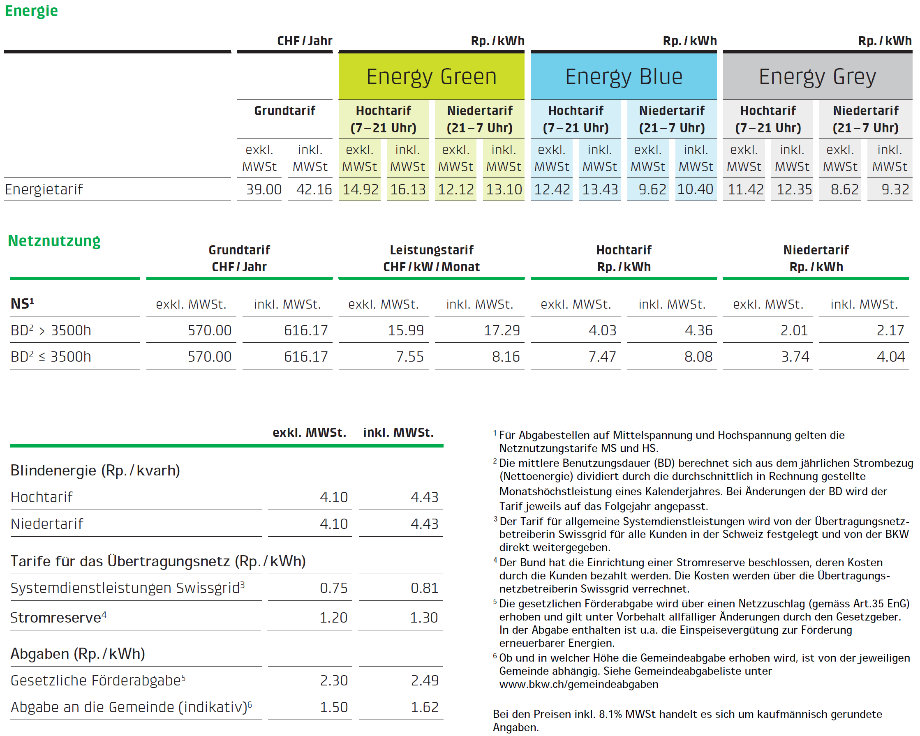
Electricity Prices
Price information for key account and industrial customers:
For customers in the basic supply with a delivery point at low voltage and an annual electricity consumption of over 50,000 kWh.
Prices valid from January 1, 2024
Electricity price
Wholesale cost
Transmission & Distribution Charges
Arbeitspreis
Leistungspreis
Green
Blue
Grey
Rp./kWh
Rp./kWh
CHF/kW/month
Taxes / Levies
Rp./kWh
Tariffs for the transmission grid
Taxes
Rp./kWh
Most studies only consider this part of the electricity price

Slide 25
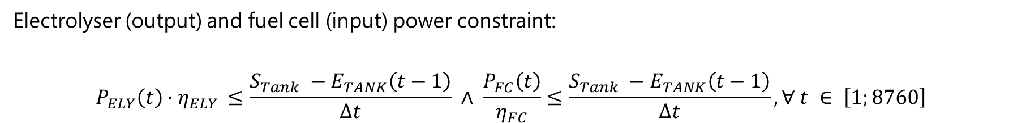

MILP Formulation: Constraints
Storage constraint:
$$E_{TANK}\left(t\right)=E_{TANK}\left(t−1\right)+ P_{ELY}\left(t\right)∙η_{ELY }∙Δt−\frac{P_{FC}\left(t\right)}{η_{FC}}, ∀ t ∈ \left[1;8760\right]$$
Electrolyser (output) and fuel cell (input) power constraint:
$$P_{ELY}\left(t\right)∙η_{ELY }≤\frac{S_{Tank} −E_{TANK}\left(t−1\right)}{Δt} ∧ \frac{P_{FC}\left(t\right)}{η_{FC}}≤\frac{S_{Tank} −E_{TANK}\left(t−1\right)}{Δt},∀ t ∈ \left[1;8760\right]$$
Size constraints - $∀ i ∈ \left[ELY;TANK;FC\right]$
$$P_{i}\left(t\right)≤S_{i}, ∀ t ∈ \left[1;8760\right]$$

Slide 26



MILP Formulation: Constraints
Fuel cell initialization constraint:
$$P_{FC}\left(0\right)≤\frac{E_{TANK}\left(0\right)}{Δt}$$
Periodicity constraint:
$$E_{TANK}\left(0\right)= E_{TANK}\left(8760\right)$$
Power balance:
$P_{ELY}\left(t\right)+P_{C}\left(t\right)+P_{exp}\left(t\right)+P_{Demand}\left(t\right)≤P_{FC}\left(t\right)+P_{PV}\left(t\right)$ + $P_{Imp}\left(t\right)$

Slide 27
Maxime Fischer
fmaxime@student.ethz.ch
ETH Zürich
D-MAVT, Maschineningenieurwissenschaften (Mobilität) Building LEO
Leonhardstrasse 27,
8092 Zürich
https://rre.ethz.ch/

